Slide 1

A Smoking Gun Classifier
Exploring the Enron Email Corpus

Slide 2
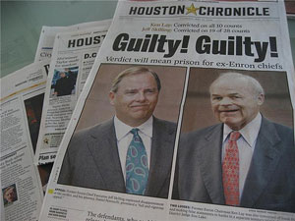
Notes:
63.5 billion dollar bankruptcy, over $90 to under $1. stock options, "What earnings do you need to keep our stock price up?“, overcompensation of board and lack of awareness in regards to cost

Slide 3
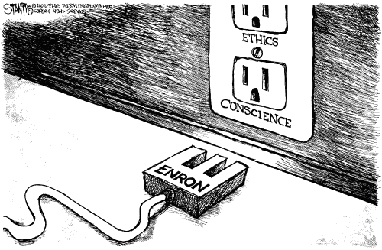
Notes:
however, the Enron Corpus is also a depiction of morality. we just need to decode it.

Slide 4
Why Emails?
interesting class of written text
open domain problem
a useful solution
presents unique challenges and solutions
network theory
Notes:
1. the use of emails increasing by A TON. 2. applications to sociolinguistics, NLP, historical ling (shortenings, etc), pragmatics and semantics, etc. 3. see 1. 4. NETWORK THEORY.

Slide 5
“I am distributing this dataset as a resource for researchers who are interested in improving current email tools, or understanding how email is currently used. This data is valuable; to my knowledge it is the only substantial collection of "real" email that is public. The reason other datasets are not public is because of privacy concerns. In using this dataset, please be sensitive to the privacy of the people involved (and remember that many of these people were certainly not involved in any of the actions which precipitated the investigation.)”

Slide 6
Goals
accuracy
find useful features
understand the corpus better
Notes:
accuracy, interesting baseline vs. goals. baseline a real judge of success?

Slide 7
The Data

Slide 8
Metadata
History
Size
500,000 files
3,500 folders
1.7GB
Version
Notes:
screenshots here. 1. top level. 2. user level. 3. folder level. 4. email level (or not?)

Slide 9
Data Hierarchy
“maildir/”
user level
folder level
email level*
Notes:
screenshots here. 1. top level. 2. user level. 3. folder level. 4. email level (or not?)

Slide 10
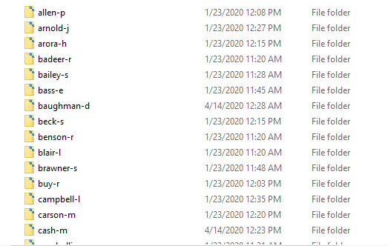
User Level

Slide 11
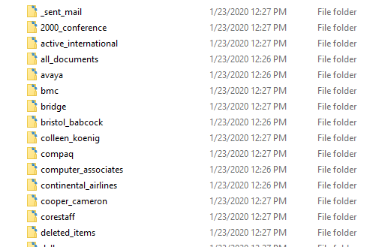
Folder Level

Slide 12
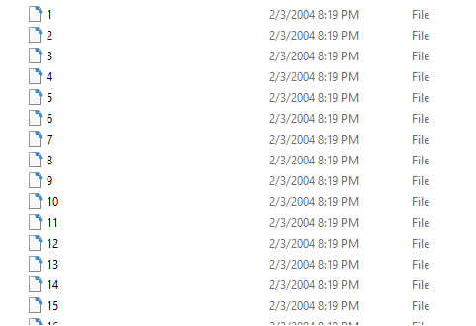
File Level

Slide 13
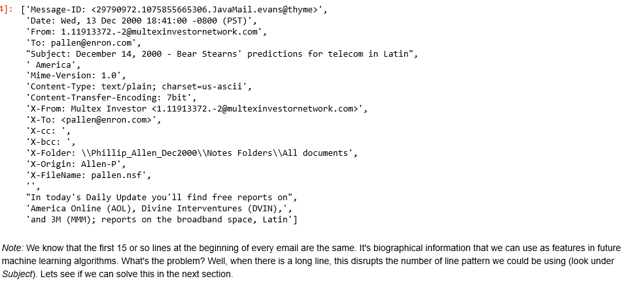
An Email

Slide 14
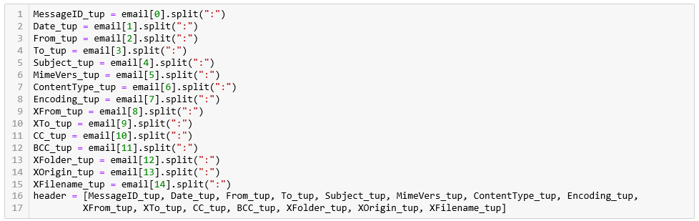
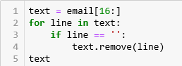
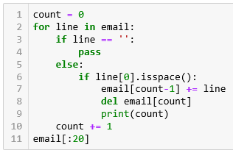
Techniques: Raw Parse
Notes:
assumptions: commas here, 2nd part here, etc. note exception handling as extremely important

Slide 15
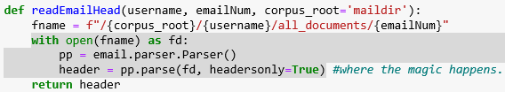
Techniques: Email.Parser Module

Slide 16
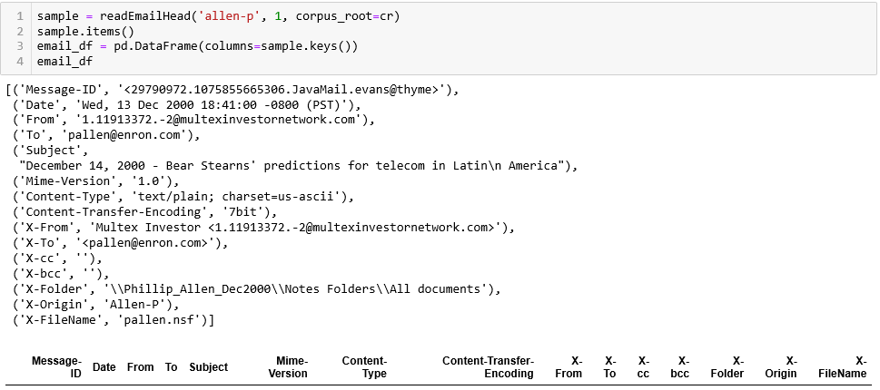
Techniques: Email.Parser Module
Notes:
assumptions: e.p is a function that works (real consideration), gives a limited view of data

Slide 17
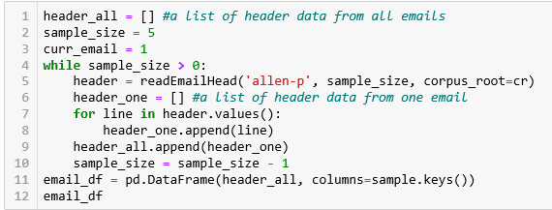
Techniques: Email.Parser Module

Slide 18
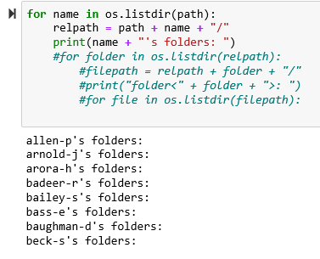
Techniques: OS Module
Notes:
os.walk vs. my method, assumptions: the bottom layer, sparse files in folder level, etc. exception handling a key here.

Slide 19
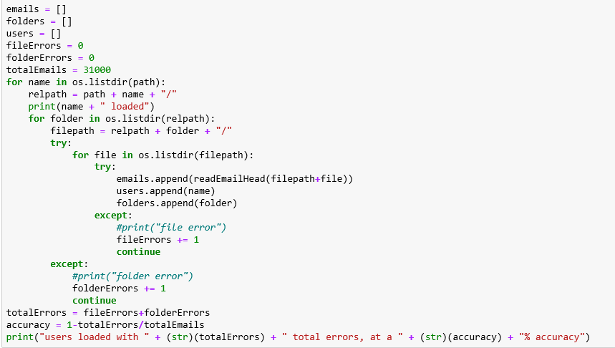
Techniques: OS Module

Slide 20
Viability of OS Walking
coverage
assumptions
other corpora?

Slide 21
Data Exploration and Machine Learning
Manual Annotation:
problems
benefits
Unsupervised to Supervised:
problems
benefits
Notes:
manual annotation: could prove extremely valuable outside of my project (annotate for other things as well). also removes any ML related uncertainty, gives more of a feel for the corpus. however, how many emails? 10k? that’s a lot… even then we’re wasting data here.
U to S: slightly more difficult and some techniques abstracted away, but ultimately will provide better coverage and is not unintuitive.

Slide 22
Future Directions and Core Takeaways
summer project
apply for fall conferences
BPhil
data cleaning takes forever
exceptions are a must
look hard for previous solutions
sometimes just move on

